Slide 1

Story Massage
By Sophie Webster
Massage Therapist
Brighter Futures for Children

Slide 2
Rules!
1) Always ask permission to touch your partner and say thank you at the end.
2) The noise level should never reach higher than the music.
3) This is a calming activity.

Slide 3
The 10 Strokes
The Circle
The Wave
The Fan
The Walk
The Drum
The Claw
The Squeeze
The Bounce
The Sprinkle
The Calm

Slide 4
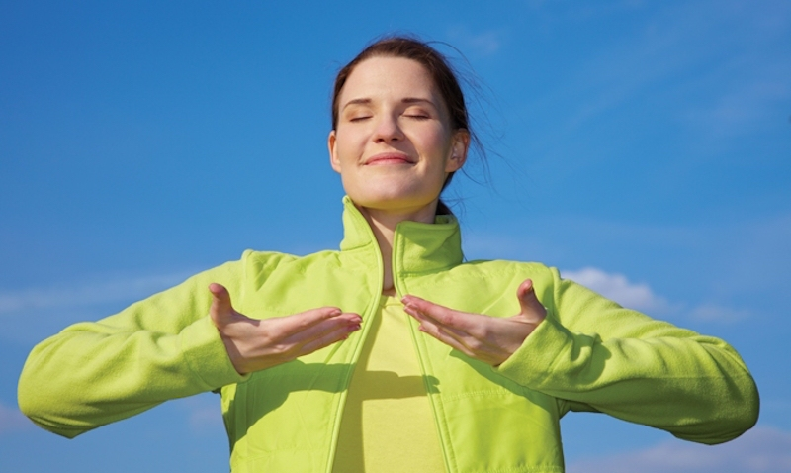
Breathing x3
Breathe in through the nose…hold for 3 seconds…and breathe out slowly and quietly through the mouth.

Slide 5
Ask Permission to touch your partner

Slide 6

The Circle
Rest one hand on your partners shoulder. With the flat of other hand, make a circular movement on the back. This can be in a clockwise or anti-clockwise motion, making circles big and small.

Slide 7

The Wave
Rest one hand on your partners shoulder. With the flat of other hand, make a wave like, zig-zag movement across your partners back. This can be vertical or horizontal.

Slide 8

The Fan
Starting at the base of the back, with both hands, flat, either side of the spine. With both hands working at the same time, move up the back, fanning out across the shoulders. You can also do this starting at the top of your partners back and fanning out at the base.

Slide 9

The Walk
Begin by placing the flat of one hand on your partners back, now place your other hand above. Repeat this walking process across the back.

Slide 10

The Drum
Cup your hands and gently tap the back.

Slide 11

The Claw
Place your hands in a claw like position on your partners back. Stroke your hands in a downwards movement, with the pads of your fingers and thumbs being in constant contact with the back.

Slide 12

The Squeeze
Place both hands on the top of your partners shoulders. Gently squeeze and release. This can also be done on the arms.

Slide 13

The Bounce
With both hands working at the same time, place the pads of fingers and thumbs on your partners back. Gently squeeze the fingers and thumbs of each hand together, and lift off, quickly. Repeat this all over the back.

Slide 14

The Sprinkle
With both hands working at the same time, lightly tap with the pads of your fingers, in a random fashion, across your partners back. This can also be done on the head, shoulders, and arms.

Slide 15
The Calm
Rest the flats of both hands gently on the back, head, or shoulders. Hold for as long as feels comfortable.

Slide 16
Say thank you!

