Slide 1
Trimming My Nails
By Sophie Webster

Slide 2

Breathing x3
Breathe in through the nose…hold for 3 seconds…and breathe out slowly and quietly through the mouth.

Slide 3
Ask permission to touch your partner

Slide 4

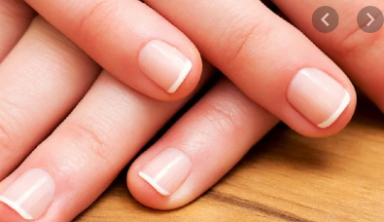
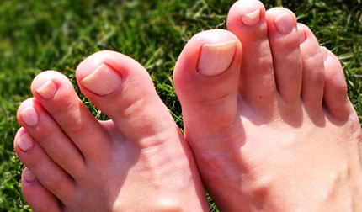
The Fan
My finger and toe nails grow every day.

Slide 5

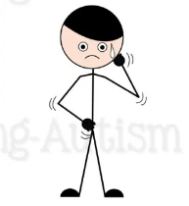
The Bounce
If my nails are too long, they might snap or scratch me or someone else. This could hurt!

Slide 6

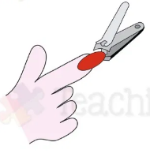
The Circle
Everyone has to trim their nails so that they do not snap or scratch me or someone else.

Slide 7

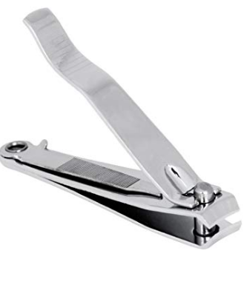
The Sprinkle
Mummy/Daddy/I will trim my nails using nail clippers or a nail file. They do not and will not hurt, I can practise on myself if I want to.

Slide 8

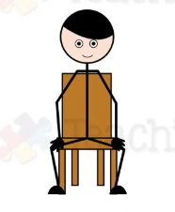
The Calm
I should sit really still when I am having my nails trimmed.

Slide 9

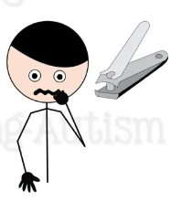
The Wave
Sometimes I might get scared of the nail clippers. This is ok! If I get scared, I need to take 3 deep breaths in.

Slide 10



The Walk
I can count each nail once it has been cut. When I count to ten, I will be finished.

Slide 11


The Squeeze
Once my nails are trimmed, I will receive ……

Slide 12

The Calm
Now my nails are shorter! Well done!

Slide 13
Say thank you to each other!

