Slide 1

The Kiwi Bird
Story Massage

Slide 2

Breathing x3
Breathe in through the nose…hold for 3 seconds…and breathe out slowly and quietly through the mouth.

Slide 3
Ask permission to touch your partner

Slide 4

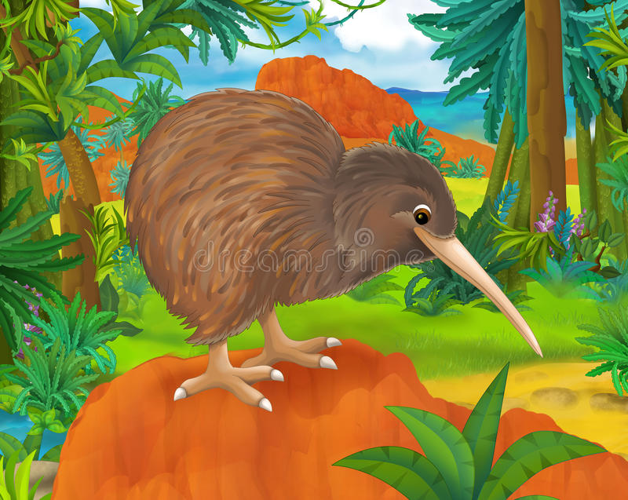
The Squeeze
Kiwi Bird lives in the forest

Slide 5

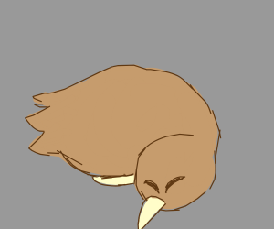
The Sprinkle
Kiwi sleeps during the day time

Slide 6

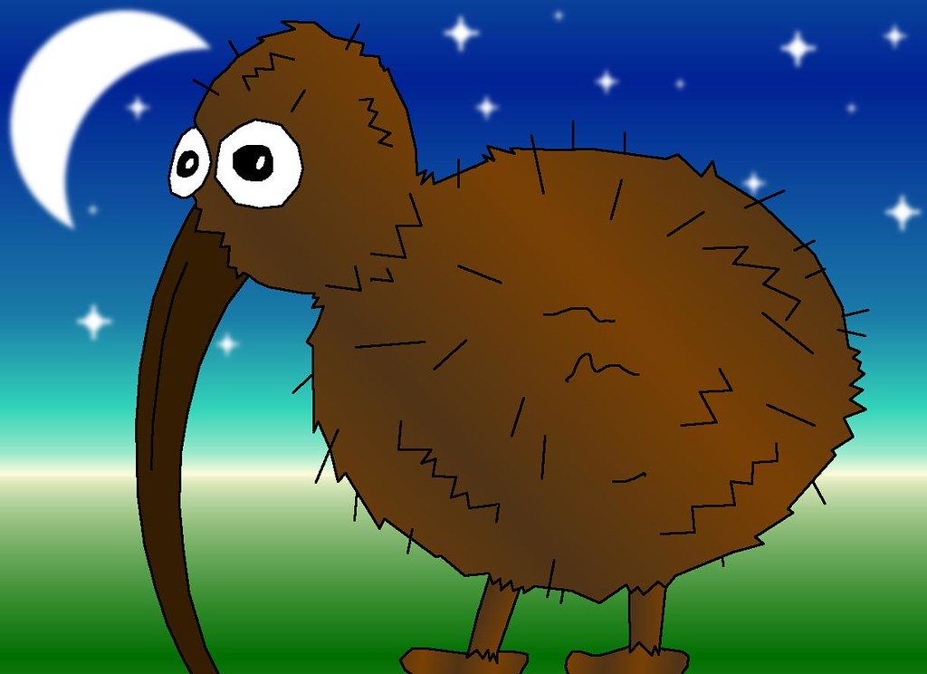
The Fan
At night he wakes up

Slide 7

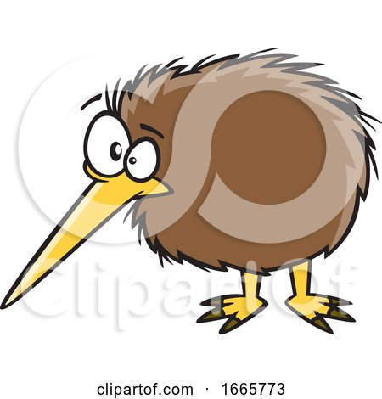
The Walk
Kiwi is hungry! So he goes looking for food

Slide 8

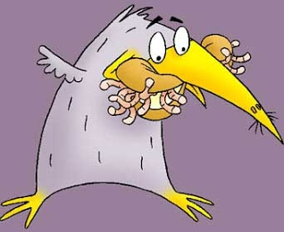
The Wave
Tonight, Kiwi finds a worm to eat. Yum Yum Yum!

Slide 9

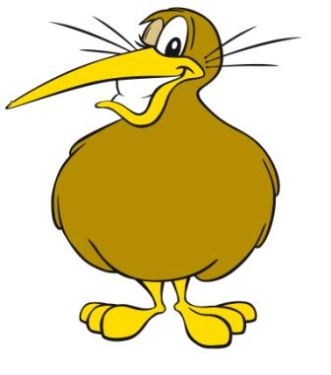
The Calm
Now Kiwi has a full stomach, and he is happy.

Slide 10
Say thank you to each other!

