Slide 1
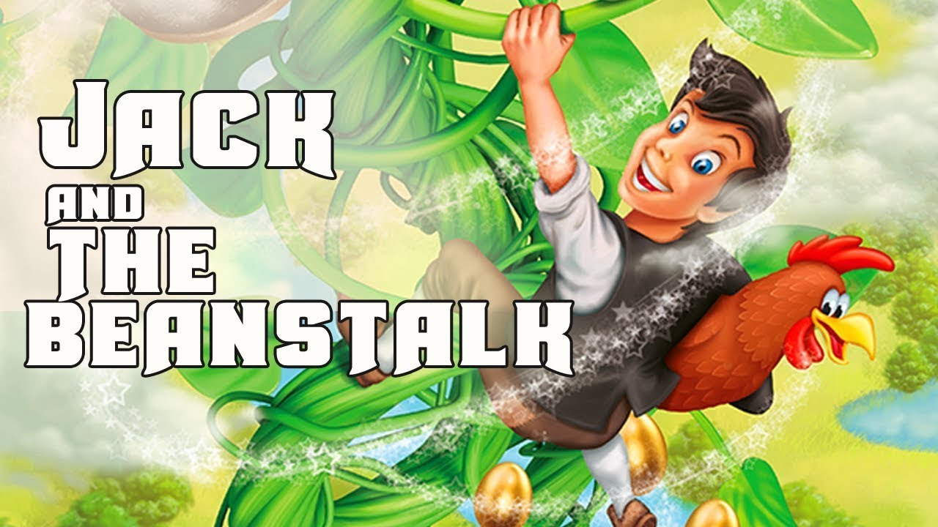
Jack and The Bean Stalk
Sophie Webster

Slide 2

Breathing x3
Breathe in through the nose…hold for 3 seconds…and breathe out slowly and quietly through the mouth.

Slide 3
Ask permission to touch your partner

Slide 4

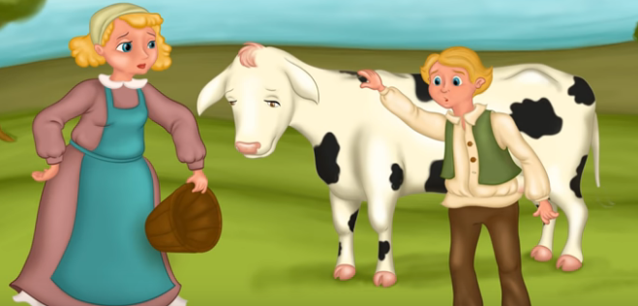
The Circle
Once upon a time there was a boy called Jack. He lived with his mother. They were very poor. All they had was a cow.

Slide 5

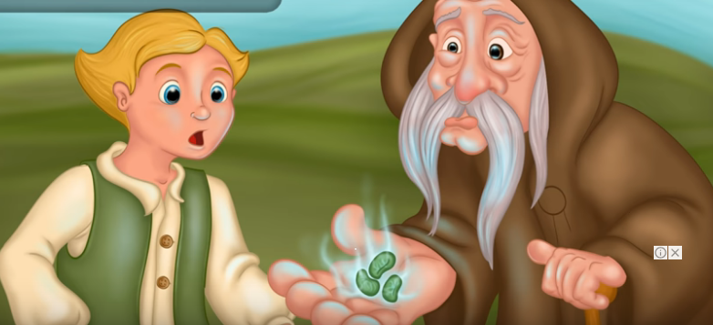
The Walk
One morning, Jack’s mother told Jack to take their cow to market and sell her. On the way, Jack met a man. He gave Jack some magic beans for the cow.

Slide 6

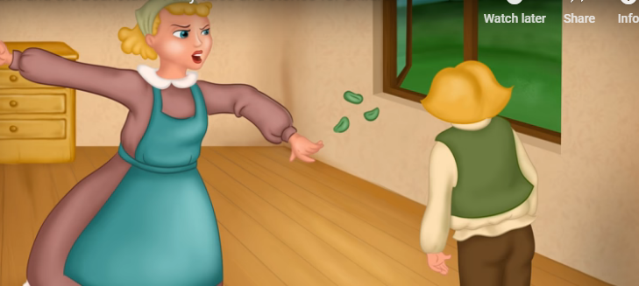
The Sprinkle
Jack took the beans and went back home. When Jack’s mother saw the beans she was very angry. She threw the beans out of the window.

Slide 7

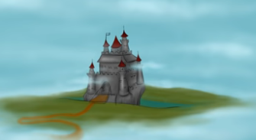
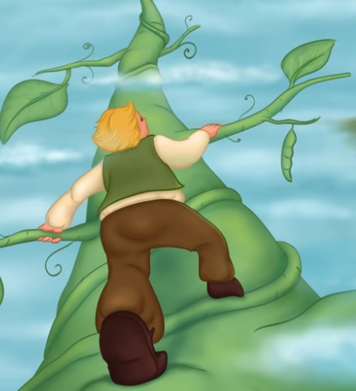
The Fan
The next morning, Jack looked out of the window. There was a giant beanstalk. He went outside and started to climb the beanstalk.
He climbed up to the sky through the clouds. Jack saw a beautiful castle. He went inside.

Slide 8

The Claw
Jack heard a voice. ‘Fee, fi, fo, fum!’ Jack ran into a cupboard.
An enormous giant came into the room and sat down. On the table there was a hen and a golden harp.
‘Lay!’ said the giant. The hen laid an egg. It was made of gold. ‘Sing!’ said the giant. The harp began to sing. Soon the giant was asleep.

Slide 9

The Wave
Jack jumped out of the cupboard. He took the hen and the harp. Suddenly, the harp sang, ‘Help, master!’

Slide 10

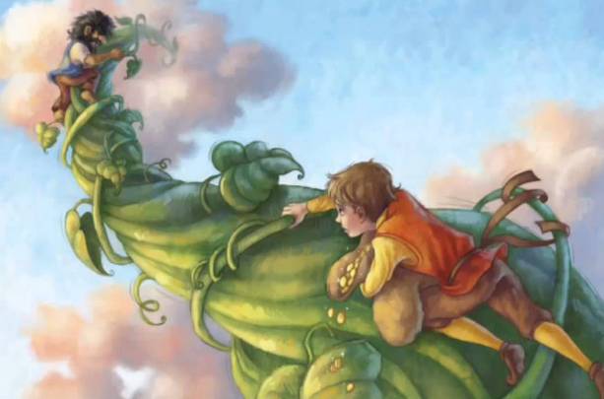
The Bounce
The giant woke up and shouted, ‘Fee, fi, fo, fum!’ Jack ran and started climbing down the beanstalk. The giant came down after him.

Slide 11

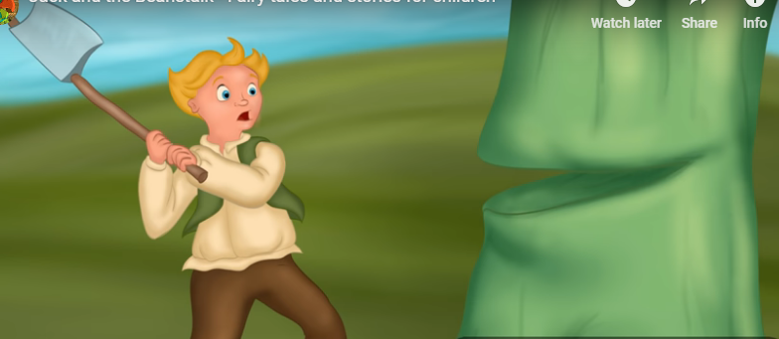
The Drum
Jack shouted, ‘Mother! Help!’ Jack’s mother took an axe and chopped down the beanstalk. The giant fell and crashed to the ground. Nobody ever saw him again.

Slide 12

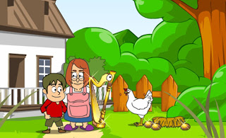
The Calm
With the golden eggs and the magic harp, Jack and his mother lived happily ever after.

Slide 13
Say thank you to each other!

