Slide 1
Hickory Dickory Dock
By Sophie Webster

Slide 2

Breathing x3
Breathe in through the nose…hold for 3 seconds…and breathe out slowly and quietly through the mouth.

Slide 3
Ask your partner if you can touch them

Slide 4


Hickory Dickory Dock

Slide 5


The mouse ran up the clock

Slide 6


The clock struck one

Slide 7

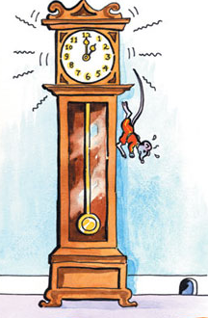
The mouse ran down
downwards

Slide 8
Hickory Dickory Dock

Slide 9
Say thank you to each other!

