Slide 1
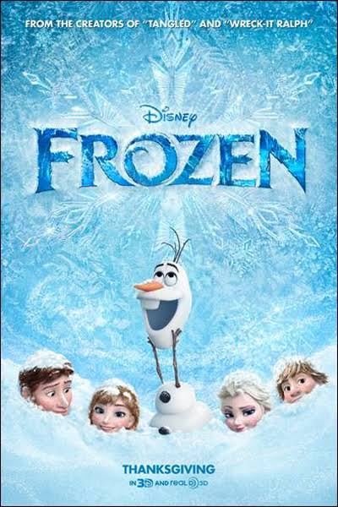
Frozen
By Sophie Webster

Slide 2
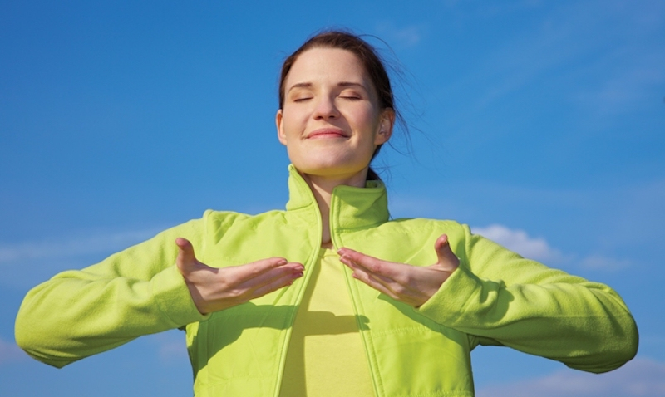
Breathing x3
Breathe in through the nose…hold for 3 seconds…and breathe out slowly and quietly through the mouth.

Slide 3
Ask permission to touch your partner

Slide 4

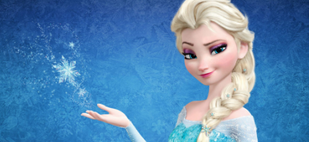
The Fan
One upon a time there lived a Princess called Elsa and her sisters name was Anna.

Slide 5

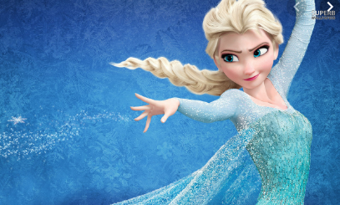
The Bounce
She was called the Snow Queen because she had special powers to freeze things.

Slide 6

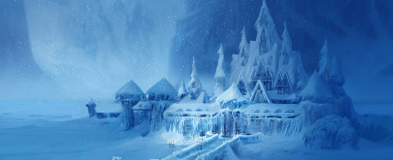
The Calm
One day, by accident, Elsa froze the whole kingdom so it was an eternal winter.

Slide 7

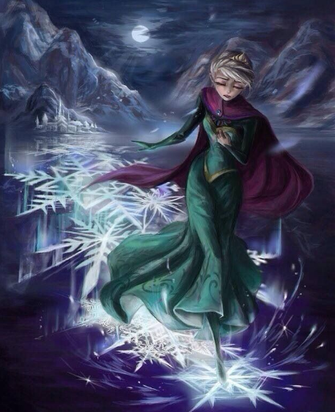
The Walk (fast)
Elsa was so upset and afraid of her powers that she ran away to hide.

Slide 8

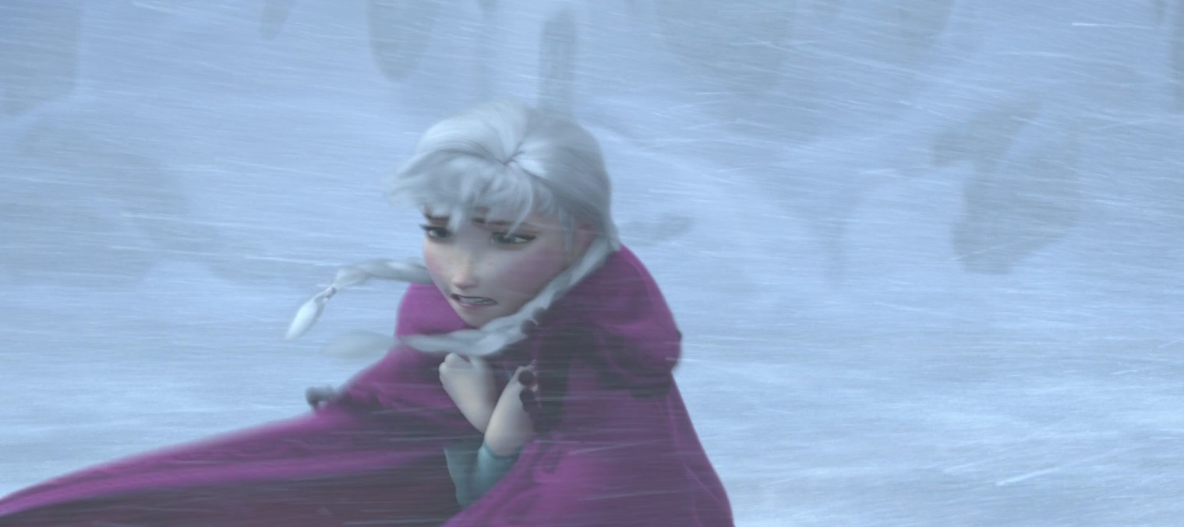
The Circle
Her sister Anna, looked everywhere for her. She was determined to find Elsa.

Slide 9

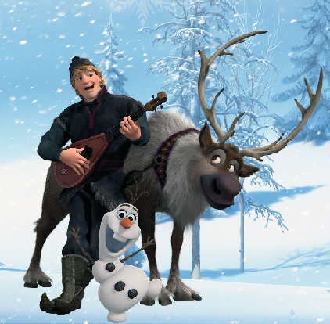
The Sprinkle
Along came a magical snowman Olaf, and a mountaineer Kristoff with his reindeer, Sven.

Slide 10

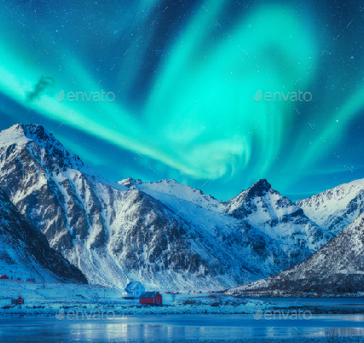
The Wave
They searched high and low, over mountains and through forests with magic at every turn.

Slide 11
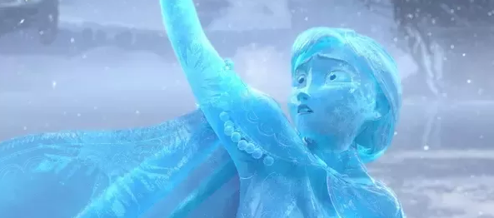
The Calm
Finally, they found Elsa, but she couldn’t control her powers and Anna became frozen!

Slide 12

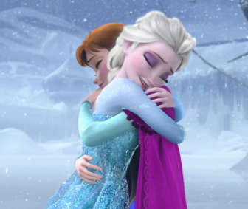
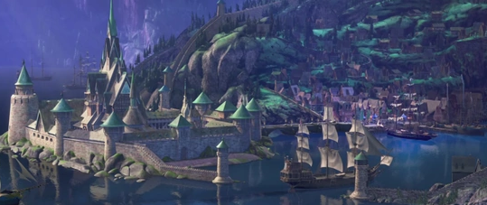
The Squeeze
Elsa was really upset and hugged her. Their love broke the spell. The kingdom melted and everyone celebrated.

Slide 13
Say thank you to each other!

