Slide 1
End of School Year Story Massage
By Sophie Webster

Slide 2
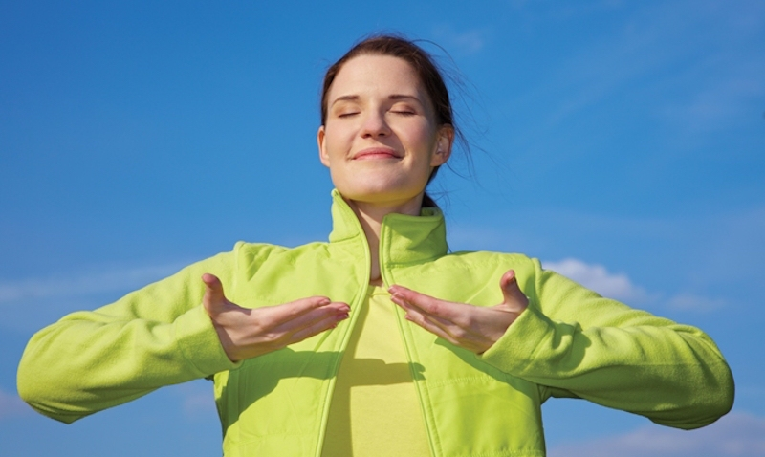
Breathing x3
Breathe in through the nose…hold for 3 seconds…and breathe out slowly and quietly through the mouth.

Slide 3

The Circle
We are all part of the family of _____________

Slide 4

The Fan
We enjoy growing and learning together with our friends and our class.

Slide 5

The Wave
Soon we will come to the end of the school year and some of us will change to a new class or go to a new school.

Slide 6

The Walk
When we walk into a new class or school we might feel worried, nervous or a mix of emotions.

Slide 7

The Bounce
But changes can bring us lots of new adventures with our friends in school.

Slide 8
The Fan
If we are feeling worried, we must remember that we can write, draw or tell an adult how we are feeling

Slide 9
The Circle
But we will all grow and change together with our friends.

Slide 10

The Calm
As we look forward to new, exciting experiences….

Slide 11
Say thank you to each other!

