Slide 1

Dear Zoo
Written By Rod Campbell
Sophie Webster

Slide 2

Breathing x3
Breathe in through the nose…hold for 3 seconds…and breathe out slowly and quietly through the mouth.

Slide 3
Ask permission to touch your partner

Slide 4


The Calm
I wrote to the Zoo to send me a pet.

Slide 5

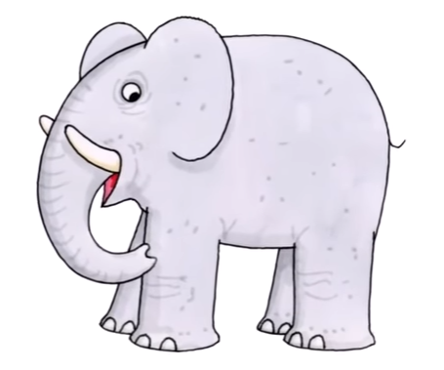
The Drum
They sent me an… Elephant! He was too big, so I sent him back.

Slide 6

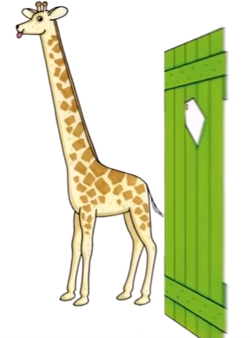
The Fan
So they sent me a…Giraffe! He was too tall, so I sent him back.

Slide 7

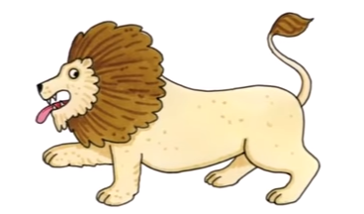
The Claw
So they sent me a…Lion! He was too fierce, so I sent him back.

Slide 8

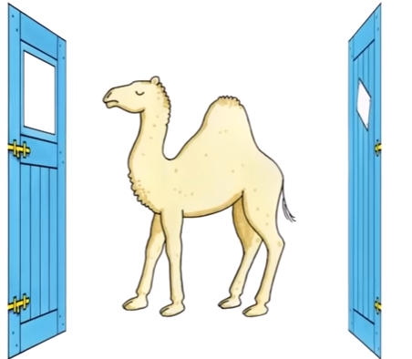
The Circle
So they sent me a…Camel! He was too grumpy, so I sent him back!

Slide 9

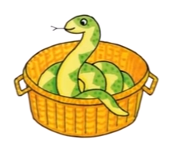
The Wave
So they sent me a…Snake! He was too scary, so I sent him back!

Slide 10

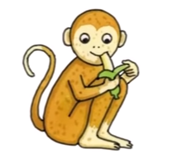
The Sprinkle
So they sent me a…Monkey! He was too cheeky, so I sent him back!

Slide 11

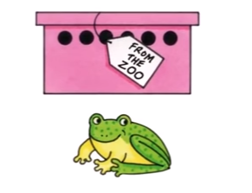
The Bounce
So they sent me a…frog! He was too jumpy, so I sent him back.

Slide 12
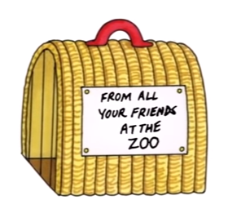
The Calm
So they thought very hard and sent me a…

Slide 13

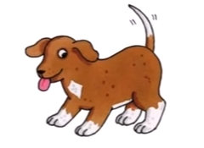
The Squeeze
Puppy! He was perfect, so I kept him!

Slide 14
Say thank you to each other!

