Slide 1
Clothing
By Sophie Webster

Slide 2

Breathing x3
Breathe in through the nose…hold for 3 seconds…and breathe out slowly and quietly through the mouth.

Slide 3
Ask permission to touch your partner

Slide 4
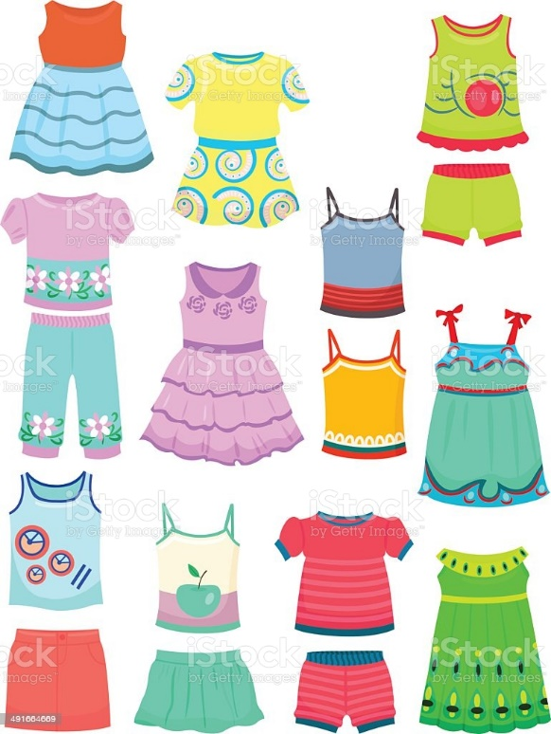
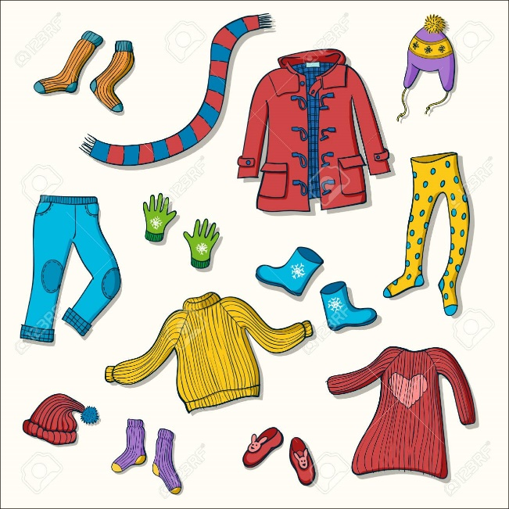
People wear clothes for lots of reasons. They keep us warm when it is cold. They protect our skin from the sun when it is hot. We also wear clothes to hide parts of our body that we tend to keep private.

Slide 5

There are places when it is OK to take off all of our clothes. This is usually at home when we are only with our families or when we take a shower or bath.
Sometimes we might need to change to wear special clothes such as PE kit or swimming wear.

Slide 6
Most of the time we are expected to have our clothes on. If we take our clothes off at the wrong time or the wrong place we can make other people upset.

Slide 7
Sometimes, our clothing might feel uncomfortable. They might feel too tight or too loose. Too big or too small. Or even too scratchy or too soft.
It is OK if clothes make us feel this way. However, wearing clothes is very important, especially clothes that are suited for certain weathers. It is ok if we wear clothes that are comfortable for us, as look as they are weather appropriate.

Slide 8
Types of School Summer Clothing:
Trousers
Skirt
Summer Dress
Polo Top
Shirt
Jumper
Cardigan
Pinafore Dress
Types of School Winter Clothing:
Trousers
Skirt
Polo Top
Shirt
Jumper
Cardigan
Pinafore Dress
Tights
Coat
Long Sleeve top
Scarf
Gloves
Thermal Socks

Slide 9
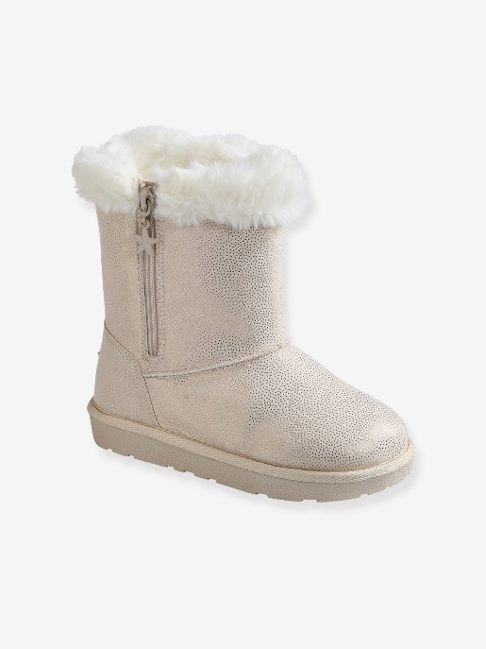
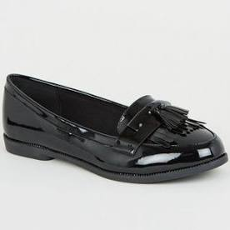
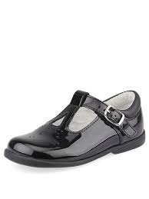
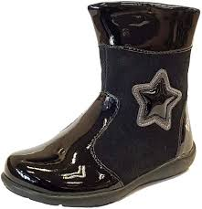
Types of Winter Shoes:
Boots
Ugg Boots
Trainers
Slip on
Wellington Boots
Types of Summer Shoes:
Boots
Ugg Boots
Sandals
Trainers
Slip on

Slide 10
We can talk to adults about how our clothes make us feel and what types of clothing we like. Adults will help us choose what clothing is appropriate, and they will also understand if clothing feels uncomfortable.

Slide 11
Say thank you to each other!

