Slide 1
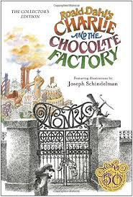
Charlie and the Chocolate Factory
Story Massage

Slide 2

Breathing x3
Breathe in through the nose…hold for 3 seconds…and breathe out slowly and quietly through the mouth.

Slide 3
Ask permission to touch your partner

Slide 4

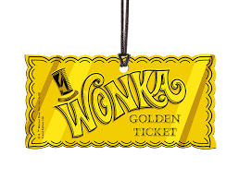
The Circle
Around the world everyone was searching for Golden Tickets in chocolate bar wrappers.

Slide 5

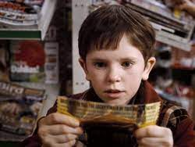
The Fan
Charlie Bucket was very poor but one day he found a coin. He used the coin to buy a chocolate bar. He was so excited when he won the last Golden Ticket.

Slide 6

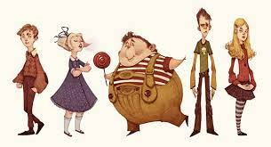
The Walk
Five children went to meet Willy Wonka at his chocolate factory.

Slide 7

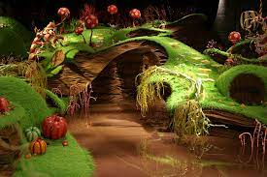
The Sprinkle
It was a feast of bubble gum and treats and sweets on trees.

Slide 8

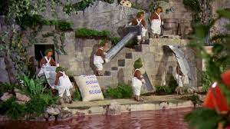
The Claw
And the Oompa-Loompas sang as they worked.

Slide 9

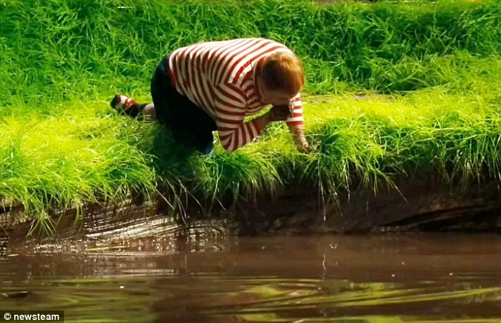
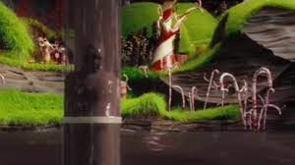
The Wave
Augustus Gloop drank from the forbidden chocolate river and was washed away.

Slide 10

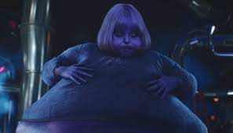
The Squeeze
Violet Beauregarde was determined to be the first to taste the chewing gum even though it was not ready. Violet turned into a blueberry.

Slide 11
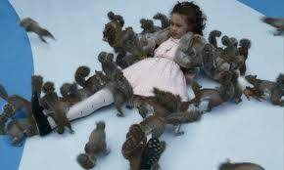
The Fan
Verucca Salt wanted everything NOW.
She fell down the bad nutt shute.

Slide 12

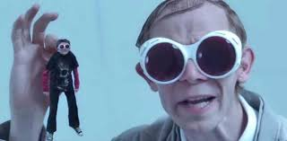
The Bounce
Mike Teavee spent so much time watching TV that he was sucked up and shown on the screen.

Slide 13

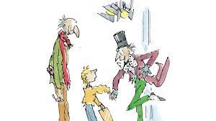
The Drum
Charlie was kind, and honest and generous.
He won the whole factory!

Slide 14

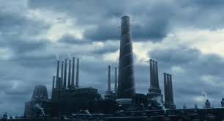
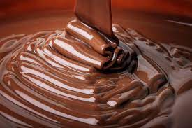
The Calm
The Bucket family moved into their new home And lived ‘chocolately’ ever after.

Slide 15
Say thank you to each other!

