Slide 1
Blood Tests
Sophie Webster

Slide 2

Breathing x3
Breathe in through the nose…hold for 3 seconds…and breathe out slowly and quietly through the mouth.

Slide 3
Ask permission to touch your partner

Slide 4

The Calm
Having blood drawn means that a nurse will take a little bit of blood from your arm. Whenever blood is drawn, there are steps that people follow.
This story will show you all the steps of having a blood test.

Slide 5

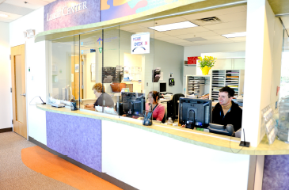
The Wave
First you check in at the Reception Desk.

Slide 6
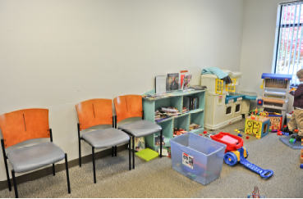
The Calm
Then we will sit down and wait in the waiting room. There may be lots of people but I will bring your ear defenders/iPad. There may be toys for you to play with.

Slide 7

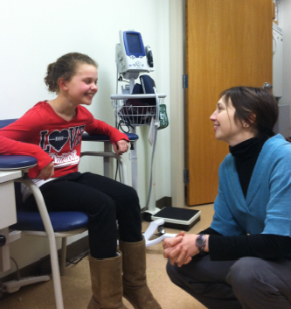
The Walk
A nurse will call your name and you will follow Mummy to the Nurse’s room. You will sit down on the chair and Mummy will sit next to you.

Slide 8

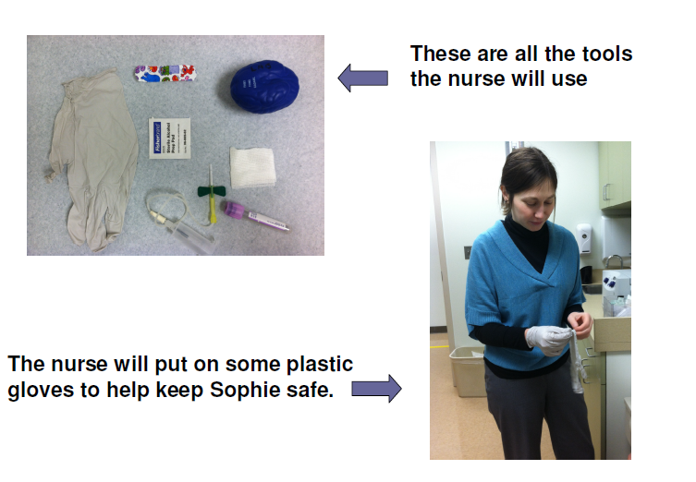
The Circle
You

Slide 9

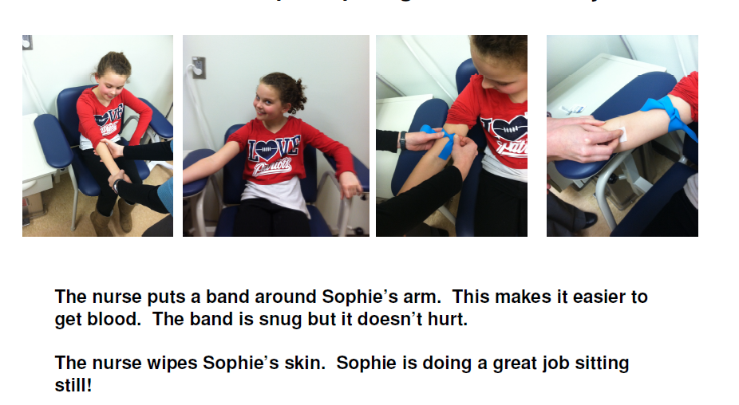
The Squeeze
your
your
You are

Slide 10

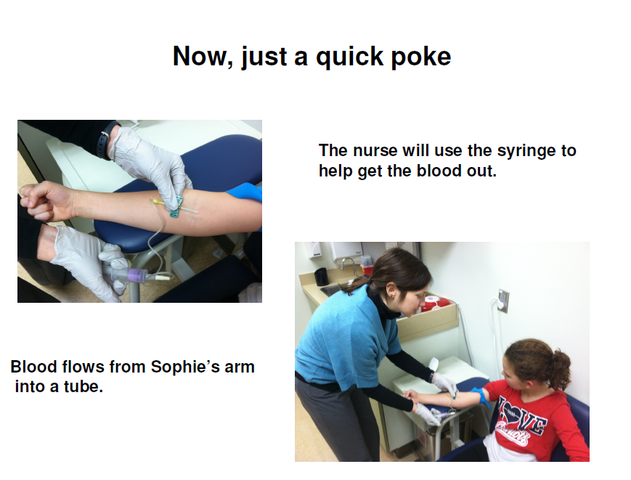
The Bounce
your

Slide 11
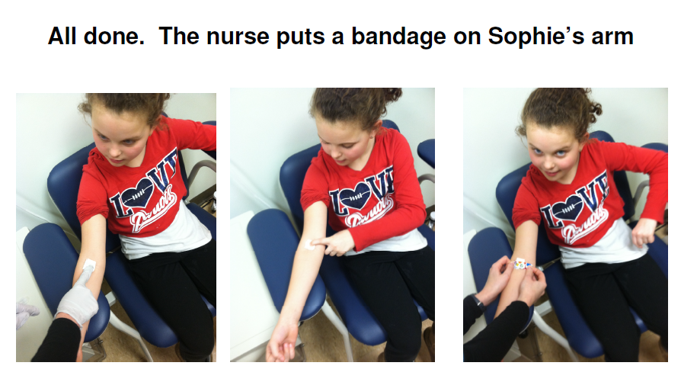
The Wave
your

Slide 12
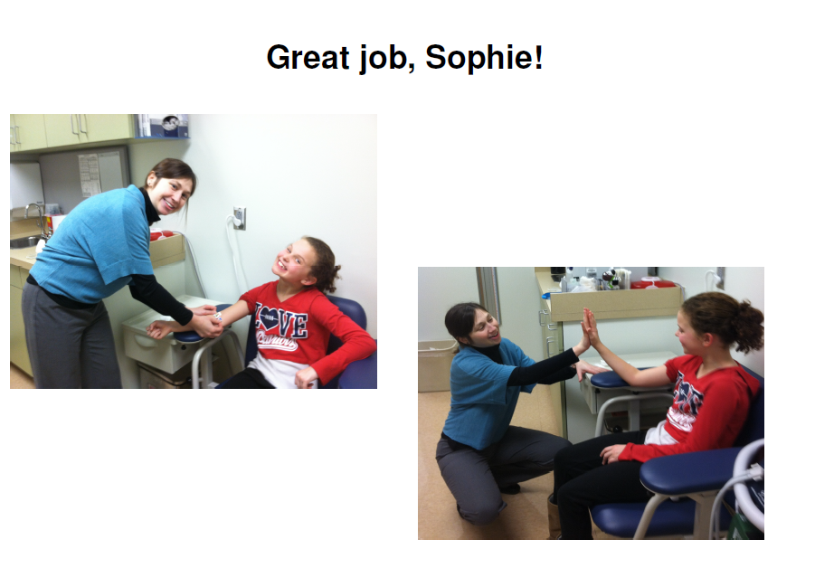
The Calm
_______!

Slide 13
Say thank you to each other!

