Slide 1
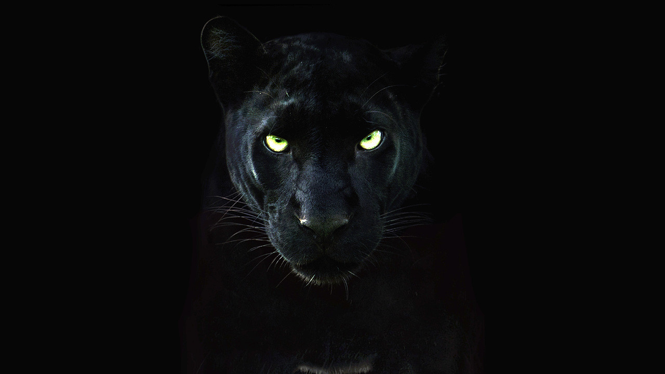
Black Panther
By Phillip

Slide 2

Breathing x3
Breathe in through the nose…hold for 3 seconds…and breathe out slowly and quietly through the mouth.

Slide 3
Ask permission to touch your partner

Slide 4
Panthers are animals with small heads, strong jaws, and emerald green eyes and tend to have hind legs that are both larger and slightly longer than those at the front.

Slide 5
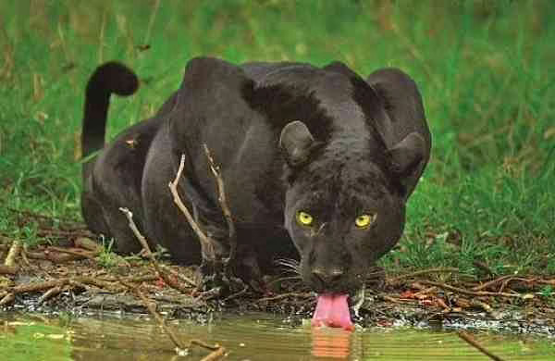
Although they are most commonly found in tropical and forests, the Panther can also be found inhabiting both marsh and swampland, along with grasslands and even more hostile areas such as deserts and mountains.

Slide 6
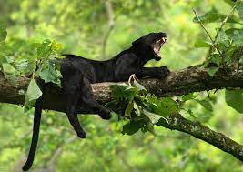
The Panther is am animal that leads a nocturnal lifestyle, spending much of the daylight hours resting safely high in the trees.
Like both the Leopard and the Jaguar, Panthers are incredible climbers and they not only rest in the trees but they are also able to keep a watchful eye out for prey without being spotted.

Slide 7
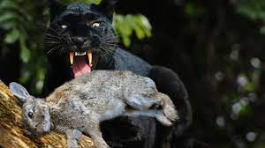
Animals including Deer, Warthogs, Wild Boar, Tapir and Antelope are all hunted by Panthers, along with smaller species like Birds and Rabbits when larger prey is scarce.

Slide 8
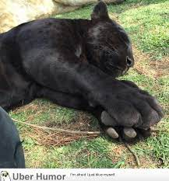
Black panthers have large and strong paws and sharp claws that are used for hunting. Panther can survive in areas populated with humans better than other cats. Panther can leap up to 20 feet. They have excellent eyesight and sense of hearing.

Slide 9

Say thank you to each other!
THE END

