Slide 1
Animal Habitats
Story Massage

Slide 2
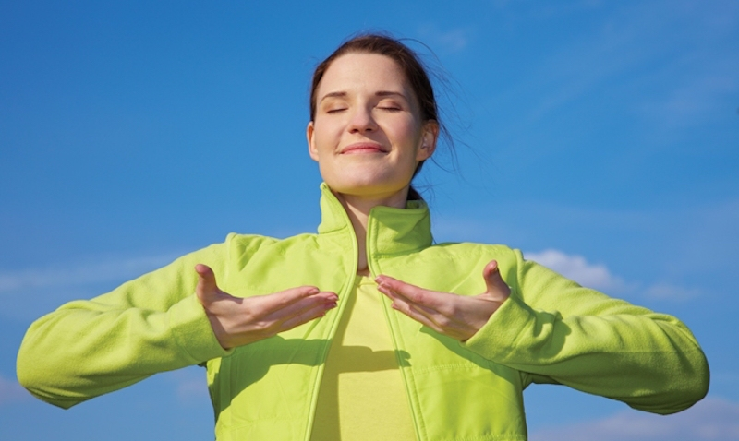
Breathing x3
Breathe in through the nose…hold for 3 seconds…and breathe out slowly and quietly through the mouth.

Slide 3
Ask permission to touch your partner

Slide 4

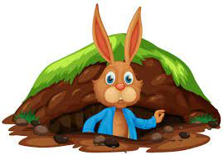
The Circle
Jamie the Rabbit lived in a burrow. He was feeling bored at home.
He wanted to live somewhere else. So, he visited his animal friends in their homes.

Slide 5

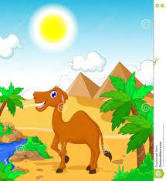
The Wave (Sideways)
Camel lived in the dessert where it was very, very hot.
Camel went to sleep standing up.

Slide 6


The Calm
Jamie didn’t want to live there.

Slide 7

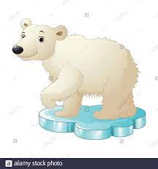
The Squeeze
Polar Bear lived in the Artic where it was very, very cold.
Polar Bear had to wear a coat of very thick fur to stay warm.

Slide 8
The Calm
Jamie didn’t want to live there.

Slide 9

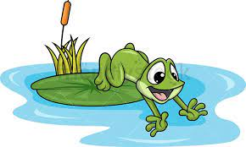
The Bounce
Frog lived near a pond to keep his skin wet. Frog ate insects like flies and moths.

Slide 10
The Calm
Jamie didn’t want to live there.

Slide 11

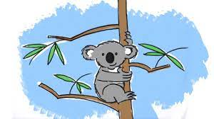
The Fan
Koala lived at the top of a Eucalyptus tree in a forest. Koala’s favourite food was leaves from the tree. She ate lots and lots of leaves.

Slide 12

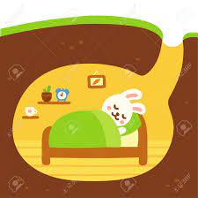
The Sprinkle
Jamie didn’t want to live there.
‘I like my home best’ said Jamie. “I don't want to live anywhere else.”
My home keeps me safe.

Slide 13
Say thank you to each other!

