Slide 1
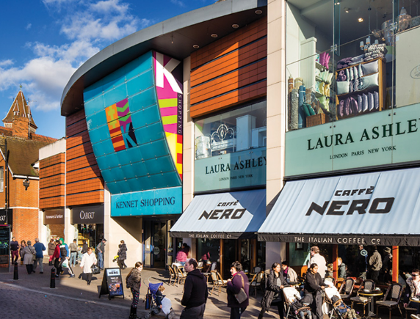
Kennet Shopping
Newbury 2026 Annual Conference
29th October 2018

Slide 2

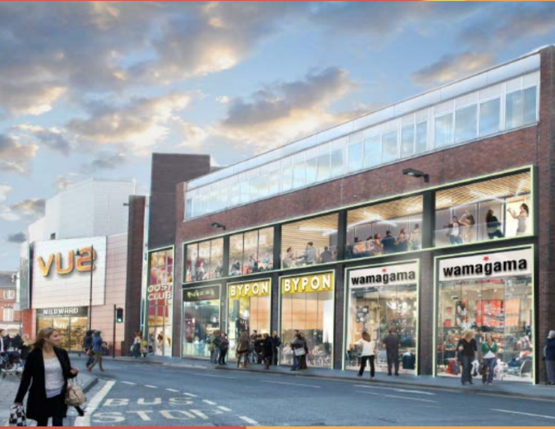
Current retail environment
National debate about the future of the high street and retail centres
Landlords are presented with challenges, most notably void rates, but also opportunities for alternative positioning of town centre properties
A fundamental shift in role of town centres and shopping centres
Local authorities have a prominent role to play by promoting flexible planning policies and supporting new visions for town centres that aren’t solely reliant on retail
Notes:
National debate:
Driven by changes in consumer spending habits/expectations
Rise of online retailers and the Amazon generation
The regeneration effect of creating regional super retail hubs drawing shoppers away from traditional market town retail offer
Fundamental shift away from a purely retail destination towards one based on experiences and leisure activities
Potential in today’s budget for government to introduce greater flexibility for change of use from retail to resi

Slide 3
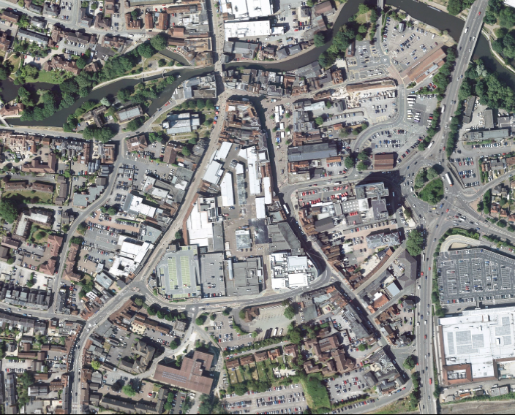
Our strategy for Kennet Shopping
Our strategy is to develop Kennet Shopping into a sustainable, mixed-use, lifestyle led destination
Engagement is key to driving footfall
Significant investment has already been made in the centre, despite the challenging retail climate
We are committed to Kennet Shopping and making it a success for Newbury
Notes:
National debate:
Driven by changes in consumer spending habits/expectations
Rise of online retailers and the Amazon generation
The regeneration effect of creating regional super retail hubs drawing shoppers away from traditional market town retail offer
Fundamental shift away from a purely retail destination towards one based on experiences and leisure activities
Potential in today’s budget for government to introduce greater flexibility for change of use from retail to resi

Slide 4
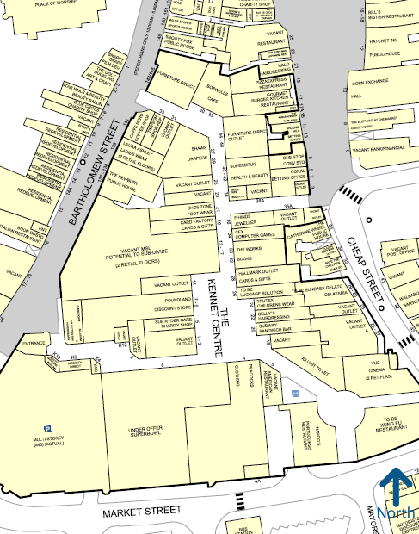
Kennet Shopping: Update
Appointment of Global Mutual as asset manager
Strong focus on leasing and renewals
Investigation of complementary uses
Pivot towards increasingly diversified tenant mix

Slide 5








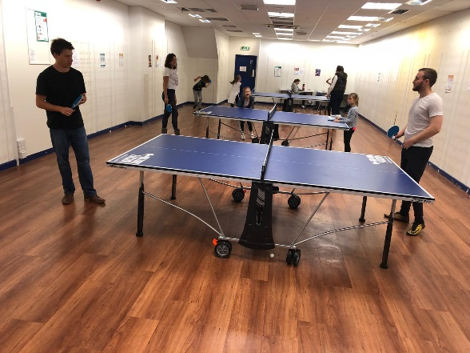
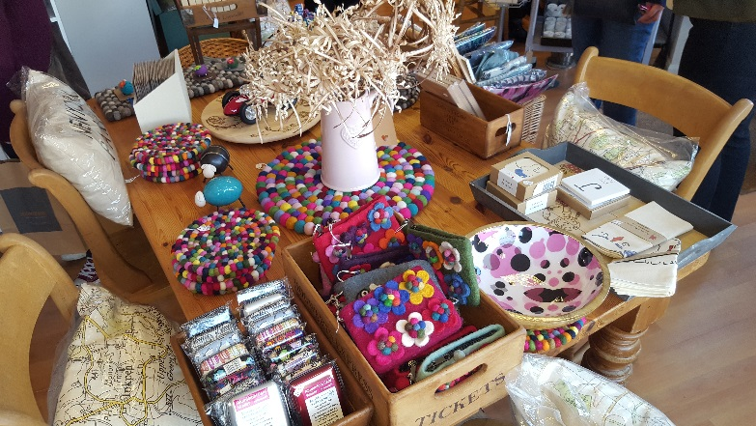
Kennet Shopping: Update
Recent renewals / relocations:
New brands introduced:

Slide 6
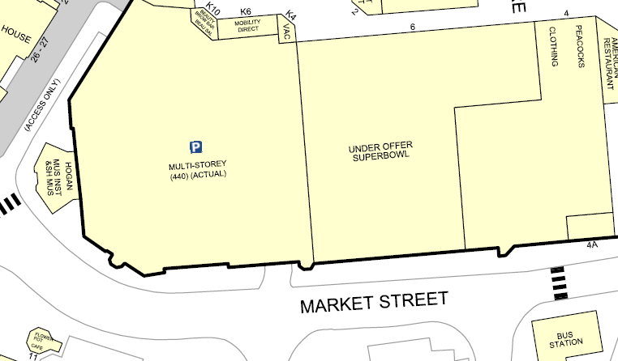
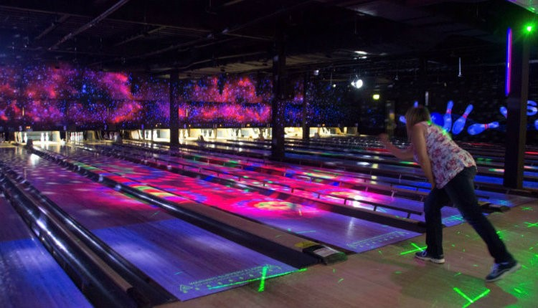

Breaking news: Superbowl
Ten-pin bowling alley
Children’s activity and play area
Ninja-Tag obstacle course
Experience-led national leisure brand
Underpins local F&B economy

Slide 7
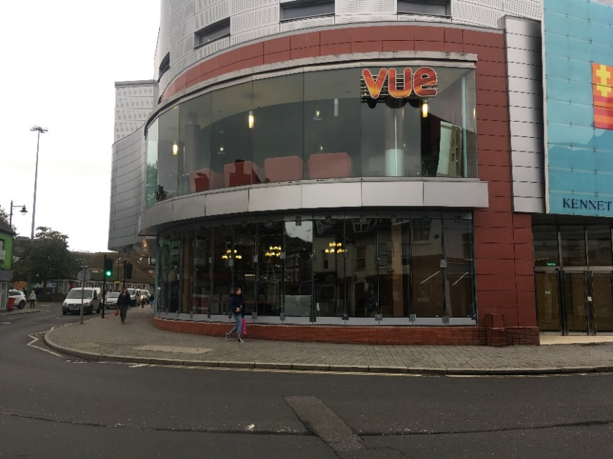
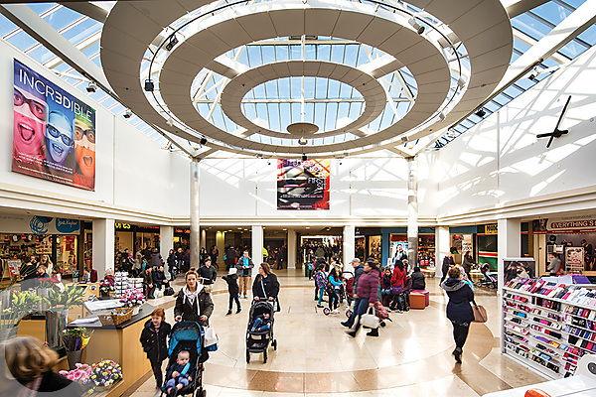
2019 and beyond
Working with local stakeholders to diversify the offering within Kennet Shopping – less retail, more alternative uses
Integration with new residential schemes and infrastructure enhancements
Focus on driving footfall around all areas of the town centre
Emphasis on convenience shopping for the local community
Securing sustainable tenancies is key

